Slide 1
Color2Gray : Salience-Preserving Color Removal
Taekyu Shin
Some slides from Gooch’s color2gray presentation.

Slide 2
What is Color-to-Gray?

Slide 3
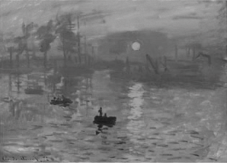
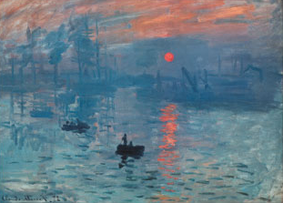
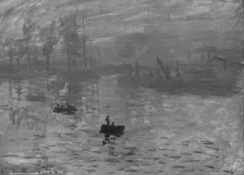
What if?
Color
Photoshop

Slide 4
Color2gray : Salience-Preserving Color Removal
Meaningful visual experience
Discriminating feature at cost of accuracy
How?
Human vision is sensitive to change.
Not Absolute values!

Slide 5


Isoluminant Colors
Why the Sun disappears

Slide 6
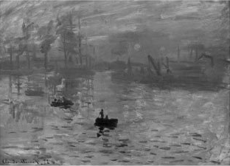
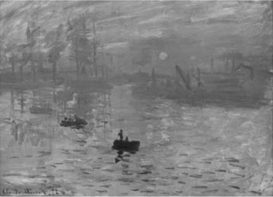
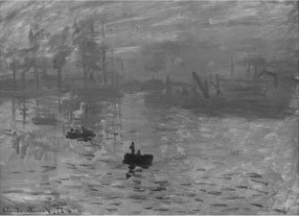
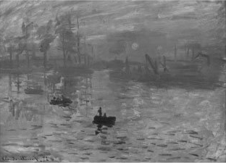
Traditional Methods: Luminance Channels
Problem can not be solved by
simply switching to a different space
CIE CAM 97
Photoshop LAB
CIE XYZ
YCrCb

Slide 7
We Consider Color/Brightness Changes!

Slide 8
3 Challenges = User-defined Parameters
μ :
Radius of neighboring pixels
α :
Max chrominance offset
θ :
Map chromatic difference to increases or decreases in luminance values

Slide 9
Challenge 1: Where to get changes from / How to apply changes Consider Influence of neighboring pixels

Slide 10
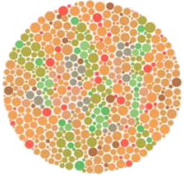
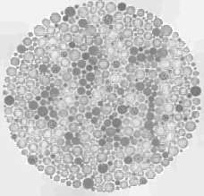
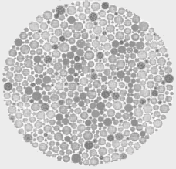
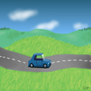
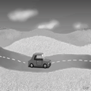
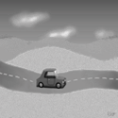
μ : Neighborhood Size
μ = 16
μ = 16
entire image

Slide 11
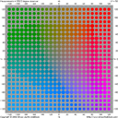
Challenge 2: How much contrast depending on the colors?
120, 120
100
0
-120, -120

Slide 12




α: Chromatic variation maps to luminance variation
α
crunch(x) = α * tanh(x/α)
−α
➔ Stretch → α times
α = 5
α = 10
α = 25

Slide 13
Challenge 3: Many Color2Gray Solutions
Original
.
.
.

Slide 14
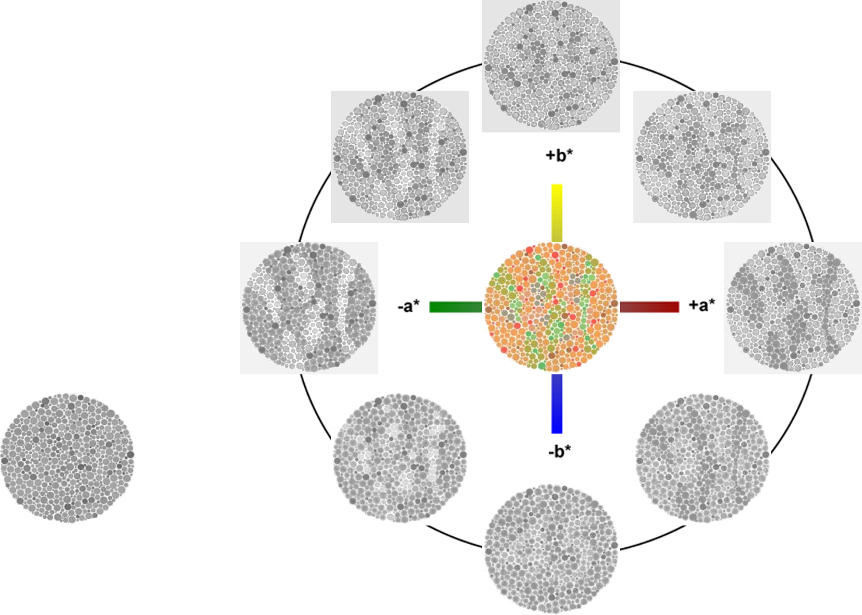
θ − Which color should be brighter
θ = 135
θ = 45
θ = 0
Grayscale

Slide 15
Color
Difference
Space
+ΔC_{1,2}
+Δb*
v_{θ} = (cos θ, sin θ)
+
-
v_{θ}
θ
-Δa*
+Δa*
+
-
sign(||ΔC_{i,j}||) = sign(ΔC_{i,j} . v_{θ} )
-Δb*

Slide 16
Algorithm Overview
Convert to Perceptually Uniform Space
CIE L*a*b*
Initialize image, g, with L channel
For every pixel
Compute Luminance distance
Compute Chrominance distance
δ_{ij}
Adjust g to incorporate both luminance and chrominance differences

Slide 17
Color2Grey Algorithm
How to compute δ_{i,j} ??
Optimization:
min Σ Σ ( (g_{i} - g_{j}) - δ_{i,j} )²
i+μ
i
j=i-μ
L component Difference between the center pixel and the neighbor pixel
Chrominance and Luminance difference
Notes:
Use conjugate gradient iterations to descend to a minimum

Slide 18
Perceptual Distance
ΔL_{ij} = L_{i} - L_{j}
Luminance Distance:
Chrominance Distance: ||ΔC_{ij}||

Slide 19
How to Combine Chrominance and Luminance
ΔL_{ij}
if |ΔL_{ij}| > crunch(||ΔC_{ij}||)
δ(α,θ)_{ij} =
crunch(||ΔC_{ij}||)
if ΔC_{ij} . ν_{θ} ≥ 0
crunch(-||ΔC_{ij}||)
otherwise
.
.
.

Slide 20
Color2Grey Algorithm
Optimization:
min Σ Σ ( (g_{i} - g_{j}) - δ_{i,j} )²
i+μ
i
j=i-μ
Basically, we get the point where
((g_{i} – g_{j}) == δ_{i,j})
Notes:
Use conjugate gradient iterations to descend to a minimum

Slide 21
Robust Color-to-gray via Nonlinear Global Mapping

Slide 22
Robust Color-to-gray via Nonlinear Global Mapping
Local Mapping
Spatially Varying (Feature discriminability)
inaccurate Color ordering
Global Mapping
Homogeneous conversion(Same color => Same grey)
More challenging
Global Mapping is the answer

Slide 23
This paper resolves :
Mapping Consistency
Same color ➔ Same grey value
Feature Preservation
Do not lose the sun!
Ordering Preservation
Bright color ➔ Bright grey value
Lightness Fidelity
After all color-conversion, viewers feel the same brightness from the greyscale.
Previous paper fails this
Previous paper is better
Previous paper – User Defined
Previous paper fails this

Slide 24
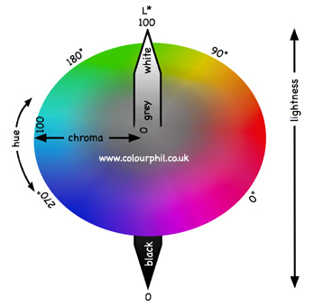

Global Mapping
L, C, theta
Lightness, chroma, hue angle
in LCH color space
A, B, A0 are unknown

Slide 25


Feature Discriminability
Gradient based optimization
Minimize Es
g -- gray value gradient
G -- color value gradient

Slide 26

Feature Discriminability
-- Sign term
α is 4 defined by the researchers.
(Experimental result)
R is also a constant.

Slide 27
Optimization
t ← cos(k * theta), sin(k * theta) x ← A, B
x , y subscript = partial derivatives

Slide 28

Optimization
Solve the matrix equation, then we get A, B, A0 values to optimize the whole equation.
Minimization by
In case of a singular matrix, put
By doing that , get the final term
The final term is minimized by

Slide 29
You can watch videos and supplementary results
http://graphics.postech.ac.kr/research/robust_c2g/

Slide 30
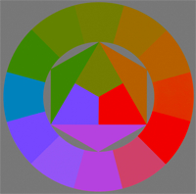
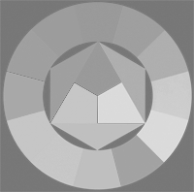




Original Nonlinear(2nd) Saliency(1st)

Slide 31
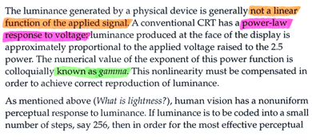
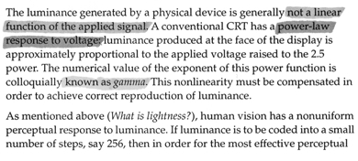
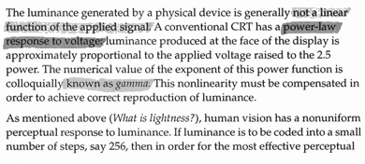



Original Nonlinear(2nd) Saliency(1st)

Slide 32
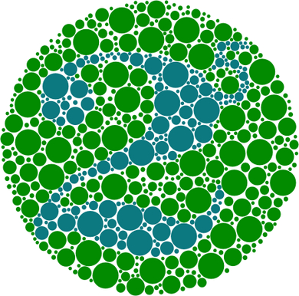
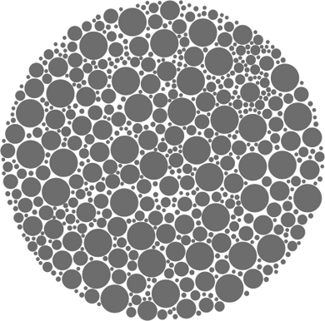
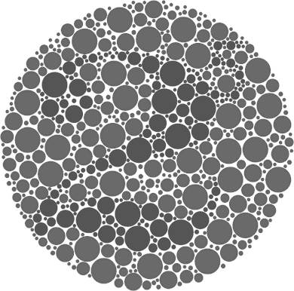
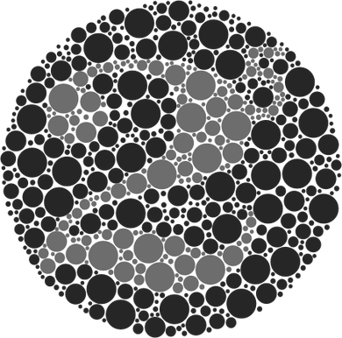
Original Nonlinear(2nd) Saliency(1st) Grundland07

